Slide 1

University of Computer Studies (Thaton) 2025-2026 Academic Year
“MyanLitBot: An AI-Powered Literary Assistant for Myanmar Fiction”
Presented by Group I
Final Year (B.C.Sc.)
CS - 5112
18.2.2026

Slide 2
Group Members
Ma Aye Aye Min San UCSTT(19-20)-024
Ma Thet Ngone Phoo UCSTT(19-20)-007
Ma Shwe Yi San UCSTT(19-20)-040
Ma Wint Nandar Lynn UCSTT(19-20)-042

Slide 3
Outline
Abstract
Introduction
Objectives
Burmese Novel Corpus
System Tools & Models
System Evolution
MyanLitBot’s Architecture
System Workflow
Feature Engineering
Contributions & Model Implementation
Evaluation
Limitations & Future Work
Conclusion
References

Slide 4
Abstract
The Burmese language suffers from a lack of large, structured digital corpora, unlike English, which benefits from resources such as the NLTK Brown Corpus and Gutenberg Corpus.
This scarcity significantly limits academic research, educational applications and literary analysis in Burmese.
This project introduces an intelligent system for exploring Burmese novels efficiently, enabling rapid retrieval of contextually relevant passages.
By integrating semantic search with AI-driven literary interpretation, the system generates coherent, human-like analyses that remain faithful to the source text.
This approach advances literary research, enhances educational resources and contributes to the preservation and accessibility of Burmese cultural heritage.

Slide 5
Introduction
This project presents an AI-based system for explaining Burmese literary works.
The system employs Retrieval-Augmented Generation (RAG) to combine retrieval and generation for accurate analysis.
Generated explanations are carefully aligned with the content of the novels.
The output emphasizes descriptive, academic-style literary interpretation.
The system provides support for computational research in low-resource Burmese language processing.

Slide 6
Objectives
To develop an intuitive and robust platform for exploring and understanding Burmese literary works
To enable precise retrieval of the most relevant story content, supporting detailed study and analysis
To generate insightful, human-like literary interpretations that facilitate critical understanding of narratives, themes and characters
To support education and literary analysis in the Burmese language
To demonstrate the potential of AI technologies in overcoming the challenges of low-resource language processing

Slide 7



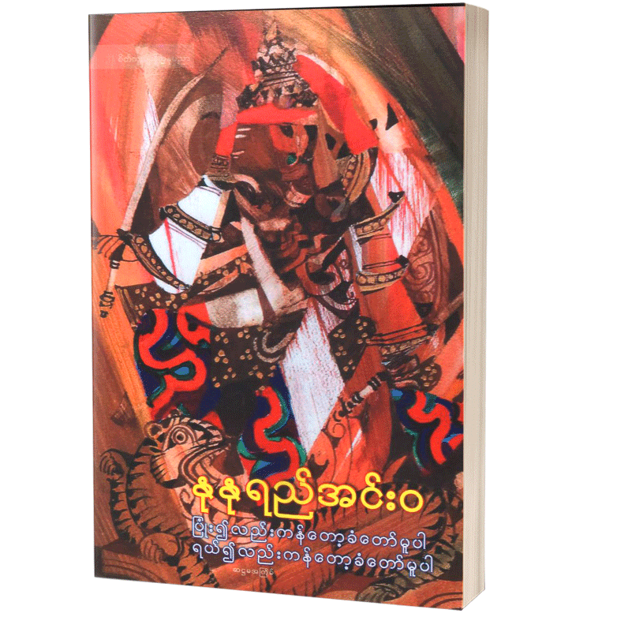

Burmese Novel Corpus
Genre: Love / Romance
Total Chapters: 8
Word Count: 13152
Character Count: 133186
Token Count: ~33297
Genre: Love / Romance
Total Chapters: 21
Word Count: 42053
Character Count: 449925
Token Count: ~112481
Genre: Biography
Total Chapters: 42
Word Count: 37598
Character Count: 463129
Token Count: ~115782
Genre: Social Realism
Total Chapters: 14
Word Count: 18702
Character Count: 209449
Token Count: ~52362
Genre: Biography
Total Chapters: 34
Word Count: 76100
Character Count:790886
Token Count: ~197722

Slide 8
System Tools & Models
Python – Core programming language (Version 3.10.12)
Sentence Transformers (LaBSE) – Multilingual sentence embeddings (Version 2.2.0)
FAISS – High-performance vector similarity search engine (Version 1.10.0)
Gemma-3-27B-IT– Instruction-Tuned Large Language Model (27B parameters)
Scikit-Learn – Analytical Utilities (Version 1.6.1)
Gradio – Web-based user interface (Version 5.23.3)
Google Colab + GPU – Model execution environment (Nov 2024 Release, Tesla T4)

Slide 9
System Evolution
Component | First Version | Second Version | Final Version
Novel Support | Single novel | 4 novels | 5 novels
Chunking | Basic | Sentence-aware | Optimized overlap
FAISS Index | IndexFlatL2 | IndexIVFFlat | IndexIVFFlat + tuning
Retrieval | No reranking | Keyword reranking | Cosine similarity reranking
LLM Quality | Raw Output | Academic output | Literary analysis
User Interface | Textbox | Chat interface | Enhanced chat interface
Performance | Slow (40-45s) | Medium(30-35s) | Optimized(6-20s)

Slide 10
Why We Needed to Improve the System
From First Version to Second Version
Problems in First Version
Duplicate sentences appeared in generated output
Incomplete or abruptly ending explanations
Limited scalability (only one novel)
Retrieval sometimes returned weak or noisy context
High LLM hallucination risk
Second Version Solutions
Implemented clean_generated_text() function with sentence deduplication
Added sentence completion check and removed imcompleted final sentences
Implemented per-novel FAISS indexes supporting 4 novels simultaneously
Added keyword-based reranking (rerank_chunks() function)
Implemented strict prompt engineering with "ဝတ္ထုအတွင်း မတွေ့ပါ" fallback

Slide 11
Why We Needed to Improve the System (Cont’d)
From Second Version to Final Version
Problems in Second Version
Out of Memory (OOM) Errors with Qwen2.5-7B (7B parameter model requires ~14GB VRAM. Colab free T4 GPU only provides ~15GB VRAM, Model loading + embeddings exceeded memory limit)
Basic keyword reranking was inaccurate
No response time tracking
Indexes rebuilt every session
Weak hallucination control
Final Version Solutions
Switched to Gemma-3-27B-IT API (zero local GPU memory)
Implemented cosine similarity reranking with LaBSE embeddings
Added real-time duration measurement for each query
Implemented persistent index storage system
Enhanced prompt with strict semantic boundary rules

Slide 12
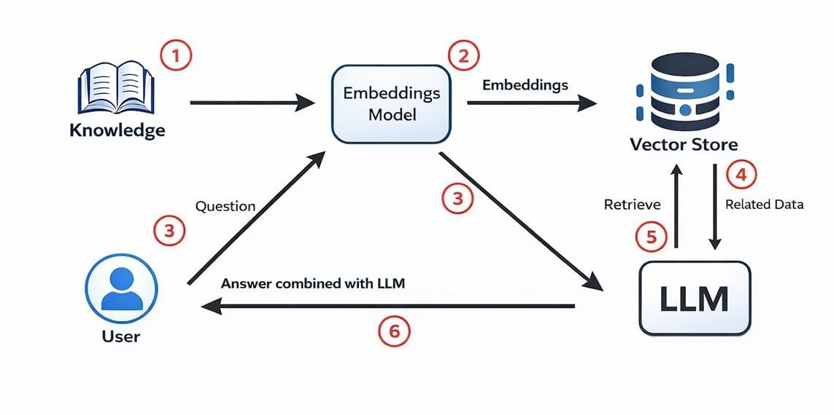
MyanLitBot’s Architecture

Slide 13
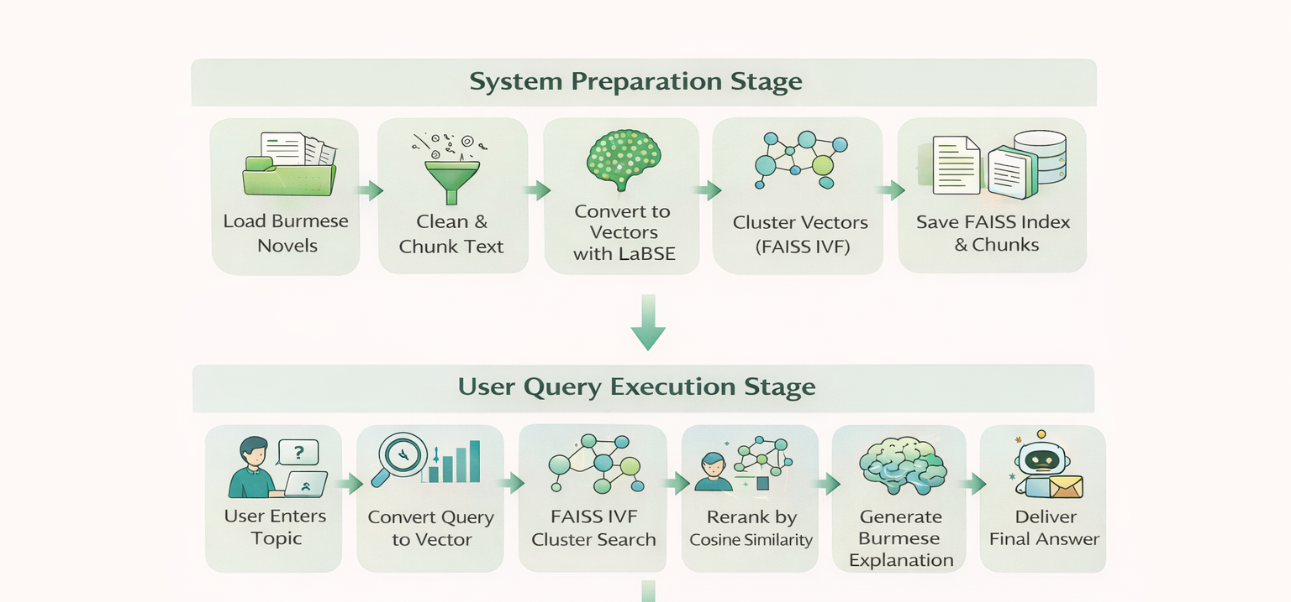
System Workflow

Slide 14
Data Preprocessing
Load novel text from Google Drive.
Remove extra line breaks.
Strip leading and trailing spaces.
Split text into sentences using punctuation (။, !, ?).
Prepare text for chunking and embedding.

Slide 15
Feature Engineering
Chunking
Multi-Novel Isolated Indexing
Sentence Embeddings and Semantic Retrieval
Smart Semantic Clustering for Efficient Search
Dynamic Cluster Adjustment
Two-Stage Retrieval
Hallucination Control & Human-Centric Prompts
Output Deduplication and Cleaning

Slide 16
1. Chunking
What is Chunking?
Chunking is the process of breaking a long Burmese novel into small, meaningful sentence-level text units so that the system can understand, search and retrieve context accurately.
Why it is important?
Preserves complete Burmese sentence meaning.
Prevents context loss using sentence overlap.
Improves FAISS semantic search accuracy.
Produces better LLM responses.
How Chunking Works
Original Burmese Text
“သူမသည်မနက်ခင်းအလင်းရောင်ကိုကြိုဆိုနေသည်။…...
……..လေညင်းသံသည် စိတ်ကို အေးချမ်းစေသည်။သူ့ကို တွေ့သောအခါ နှလုံးသားက ထိတ်လန့်သွားသည်။………”
Sentence-Aware Chunks (max_chars = 500)
Chunk 1
“သူမသည် မနက်ခင်းအလင်းရောင်ကို ကြိုဆိုနေသည်။ ……..လေညင်းသံသည် စိတ်ကို အေးချမ်းစေသည်။”
Chunk 2 (with overlap one sentence)
“လေညင်းသံသည် စိတ်ကို အေးချမ်းစေသည်။သူ့ကိုတွေ့ သော အခါ နှလုံးသားက ထိတ်လန့်သွားသည်။……”

Slide 17
2. Multi-Novel Isolated Indexing
Each novel is processed independently.
Every novel has:
Its own FAISS vector index (.index)
Its own sentence chunks file (.pkl)
Indexes are saved to google drive and reused.
Example: Multi-Novel Isolation
အမှတ်တရ: AMhatTaYa.index + AMhatTaYa.pkl
သူလိုလူ: ThuLoLu.index + ThuLoLu.pkl
Stored Files
.index → FAISS vectors (semantic space)
.pkl → Original Burmese sentence chunks
On System Restart
Indexes are loaded directly from google drive
No re-chunking
No re-embedding
User Query:
“မောင့်ကို စိတ်ထိခိုက်စေသော စကားက ဘာလဲ”
Search runs only inside “အမှတ်တရ” index
No interference from other novels

Slide 18
3. Sentence Embeddings and Semantic Retrieval
Each sentence becomes a vector.
Example: "ဗိုလ်ချုပ်အောင်ဆန်းရဲ့အကြိုက်ဆုံးရုပ်ရှင်တွေပြောပါ “
LaBSE converts it into a 768-dimensional vector.
[0.12, -0.34, 0.87, ..., 0.05] ← 768 numbers
Each number represents a hidden feature of meaning (e.g., emotion, action, context).
Sentences with similar meanings have vectors close together in 768-dimensional space.
Example retrieved chunk:
“…စစ်မဖြစ်မီက ရန်ကုန်တွင်ပြသွားသော (Wuthering Heights) (Rebecca) (Gone With the Wind) (Lady Hamilton) (Water Loo Bridge) (The Good Earth) (Suez) စသည်တို့မှာ ဗိုလ်ချုပ်နှစ်သက်သောသော ရုပ်ရှင်အချို့ပင်တည်း။…..”
Even if the words differ, LaBSE understands the semantic essence.

Slide 19
4. Smart Semantic Clustering for Efficient Search
Groups similar meaning vectors into clusters first.
Cluster 1 : Love/Emotion
“ချစ်တယ်…”
“လွမ်းဆွတ်နေသည်…”
Cluster 2 : Nature/Setting
“မိုးရွာနေသည်…”
“ပန်းပွင့်များ…”
Cluster 3 : Memories
“မှတ်မိသေးသည်…”
“ယခင်ကတုန်းက…”
Cluster 4 : Daily Life
“ထမင်းစားသည်…”
“အိပ်ရာထချိန်…”
Before searching for relevant chunks, this system dynamically decides how many clusters to search based on the query complexity and corpus size.
Query: “အထီးကျန်ခြင်း…”
Step 1: Vectorize → [0.2, -0.4, 0.7, ...]
Step 2: Find nearest cluster → Cluster 1 (Love/Emotion)
Step 3: Compare ONLY with vectors in Cluster 1 (not all clusters)
Step 4: Return best matches from Cluster 1:
“လွမ်းဆွတ်နေသည်…”

Slide 20
5. Dynamic Cluster Adjustment
nlist (number of clusters) is automatically calculated based on corpus size:
nlist = max(10, min(100, len(embeddings)//5))
Prevents under-clustering for small novels and over-clustering for large novels.
Improves indexing speed and retrieval accuracy.
Manual or capped clusters ensure memory-efficient training.
Example: Burmese Novels
အမှတ်တရ /A Mhat Ta Ya → 400 chunks → 80 clusters
သူလိုလူ / Thu Lo Lu → 3000 chunks → 100 clusters (capped)
Smaller novels → fewer clusters → maintain semantic coherence.
Larger novels → capped clusters → balance speed, memory, and relevance.

Slide 21
6. Two-Stage Retrieval (Search + Re-Ranking)
Stage 1: Fast Retrieval (FAISS IVF)
User query → vector embedding
FAISS IVF cluster search quickly retrieves relevant chunks.
Handles thousands of chunks efficiently using pre-trained clusters.
Stage 2: Precision Re-Ranking (sklearn Cosine Similarity)
Retrieved chunks → encoded as vectors
Cosine similarity computed using sklearn.metrics.pairwise.cosine_similarit
Chunks ranked by semantic closeness to the query.
Top 10 chunks selected → ensures final result is most relevant.

Slide 22
7. Hallucination Control & Human-Centric Prompts
What is Hallucination?
Hallucination occurs when an AI model generates information that is not present in the source text, inventing characters, events, or details that do not exist in the original Burmese novel.
Why it is important?
Prevents false literary analysis.
Maintains academic integrity and trustworthiness.
Ensures faithful representation of the author's work.
Protects against misinformation about Burmese literature.
How Strict Hallucination Control Works
LLM is forbidden from using external knowledge.
Generation is grounded only in retrieved novel passages.
If topic not found → returns a controlled “Not Found” response.
How Human-Centric Prompt Engineering Works
Enforces academic Burmese literary style.
Merges multiple fragments into a single cohesive paragraph.
Disallows chunk-level references or mechanical phrasing.
Eliminates introductory and concluding filler text.

Slide 23
8. Output Deduplication and Cleaning
Duplicate sentences in the generated output are automatically removed.
Repeated semantic content is filtered to avoid redundancy.
Incomplete sentences are discarded.
Abruptly ending sentences are removed.
Unwanted foreign characters are automatically removed.
Ensures clean, stable, publication-quality explanations.
Example: Generated output before cleaning:
“ဗိုလ်ချုပ်အောင်ဆန်းသည် ရုပ်ရှင်များကို နှစ်သက်သည်။ ဗိုလ်ချုပ်အောင်ဆန်းသည် ရုပ်ရှင်များကို နှစ်သက်သည်။ စစ်မဖြစ်မီက ရန်ကုန်တွင် ပြသသော…”
Final output after cleaning: “ဗိုလ်ချုပ်အောင်ဆန်းသည် ရုပ်ရှင်များကို နှစ်သက်သည်။”

Slide 24
Chunking Strategy
Aspect | First Version | Second Version | Final Version
Chunk unit | Character-based | Sentence-based | Sentence-based
Overlap | Character overlap | Sentence-level overlap | Sentence-level overlap
Sentence break risk | Possible | Eliminated | Fully Eliminated
Semantic quality | Medium | High | High

Slide 25
Retrieval Strategy
Aspect | First Version | Second Version | Final Version
Embedding Model | LaBSE | LaBSE | LaBSE
FAISS index Type | IndexFlatL2 | IndexIVFFlat | IndexIVFFlat
Search Method | Linear Search | Cluster-based Search | Cluster-based Search
Reranking Method | None | None | Cosine Similarity
Retrieval Speed | Slow | Fast | Fast

Slide 26
Contributions & Model Implementation
Implemented an LLM-based Retrieval-Augmented Generation (RAG) system.
Designed sentence-aware chunking optimized for Burmese literary text.
Used LaBSE embeddings for semantic representation of Myanmar language.
Built FAISS-based semantic retrieval with IVF clustering for efficient context selection.
Added retrieval reranking using cosine similarity to improve topic relevance.
Applied context grounding with strict prompt rules to reduce hallucination.
Supported multi-novel corpus with isolated indexes per novel.
Integrated output cleaning to remove duplicate and incomplete sentences for academic quality.

Slide 27
Evaluation
Test Corpus
Novel Title (Burmese) | Novel Title (English) | Genre | Chunks
အမှတ်တရ(ဂျူး) | Memories | Romance/Drama | [491]
ဗိုလ်ချုပ်အောင်ဆန်း အတ္ထုပ္ပတ္တိ (သခင်ကိုယ်တော်မှိုင်း) | General Aung San’s Biography | Biography | [1846]
ပြုံး၍လည်း ကန်တော့ခံတော်မူပါ ရယ်၍လည်း ကန်တော့ခံတော်မူပါ (နုနုရည်အင်းဝ) | Smiling and Laughing in Reverence | Social Realism | [702]

Slide 28
Evaluation (Cont’d)
Test Questions
Question (Burmese) | English Translation | Category
ဇာတ်လိုက်၏ အဓိကစရိုက်လက္ခဏာက ဘာလဲ | What is the protagonist's main characteristic? | Character
ဤဝတ္ထုတွင် အဓိကပဋိပက္ခကဘာလဲ | What is the main conflict in this novel? | Conflict
အချစ်ကို ဘယ်လိုဖော်ပြသလဲ | How is love portrayed? | Theme
ဝတ္ထုပါ နေရာဒေသကို မည်သို့ပုံဖော်ထားသနည်း | How is the setting described? | Setting
စာရေးသူ၏ ရေးဟန်ထူးခြားချက်က ဘာလဲ | What is distinctive about the author's writing style? | Style

Slide 29
Evaluation (Cont’d)
Summary Observations Table
Aspect | Romance | Biography | Social Realism
Retrieval Quality | Excellent at finding emotionally charged dialogue revealing inner turmoil | Highly precise factual retrieval of historical events and character traits | Very good at finding socially charged dialogue capturing identity conflicts
Response Style | Warm, emotional language focusing on internal states | Formal, analytical tone examining historical significance | Dramatic, observational style analyzing social dynamics
Faithfulness to Text | Stays close to intimate scenes and emotional dialogue | Accurately reflects historical details and character traits | Captures essence of social dynamics through direct characterization

Slide 30
Evaluation (Cont’d)
Summary Observations Table
Aspect | Romance | Biography | Social Realism
Strengths | Emotional depth Character intimacy | Conflict analysis Psychological insight | Factual accuracy Period details
Weaknesses/ Limitations | May over-focus on romance , missing other plot points | May miss peaceful , reflective moments | Less emotional range; can feel slightly distant

Slide 31
Findings
1. Genre Adaptation
The system successfully adapts to different literary genres.
Romance → Emotional and intimate tone
Biography → Analytical and factual style
Social Realism → Observational and socially focused interpretation
Adaptation is driven by genre-specific retrieved chunks.
2. Strongest Retrieval Performance
The Biography (ဗိုလ်ချုပ်အောင်ဆန်း အတ္ထုပ္ပတ္တိ) demonstrates the highest retrieval precision.Fact-based content (names, dates, events) aligns strongly with LaBSE embedding and cosine similarity search.
3. Most Challenging Genre
Romance (အမှတ်တရ) and Social Realism (ပြုံး၍လည်းကန်တော့ခံတော်မူပါ ရယ်၍လည်းကန်တော့ခံတော်မူပါ) present subtle challenges.Risk: Over-focus on dominant emotional narrative when broader summaries are required.
4. Effectiveness of Cosine Similarity
Cosine similarity ranking works effectively across all genres.Top-ranked chunks consistently match query intent with high semantic relevance.
5. Unexpected Insight
The concept of “love” in the Biography was interpreted contextually (patriotism, admiration, friendship), not romantically.This demonstrates strong contextual adaptation across genres

Slide 32
Limitations & Future Work
Limitations
The system currently supports a limited number of Burmese novels, restricted by available digitized text resources.
Retrieval accuracy depends on the quality of sentence chunking and embeddings; subtle literary nuances may still be missed.
Low-resource language constraints may cause minor retrieval errors due to limited pre-training data for Burmese models.
The system focuses on descriptive literary analysis and does not yet support comparative or cross-novel reasoning.
Future Work
Expand the corpus to include more Burmese novels, short stories, and historical texts across diverse genres.
Introduce cross-novel and comparative literary analysis features.
Develop offline or lightweight deployment options and a more accessible user interface.

Slide 33
Conclusion
The project effectively addresses the critical gap in digital resources for Burmese literature, offering a practical and accessible solution.
It provides a fast, accurate and context-aware system for exploring and analyzing novels, enhancing both academic and educational engagement.
The integration of semantic retrieval and AI-based interpretation enables meaningful and reliable literary analysis.
The project enhances access to Burmese literary resources, supporting research, education and cultural preservation.
This work demonstrates the potential of artificial intelligence to advance low-resource language studies and establishes a foundation for future research and system expansion.

Slide 34
References
Lewis, P., Perez, E., Piktus, A., Petroni, F., Karpukhin, V., Goyal, N., Küttler, H., Lewis, M., Yih, W. and Riedel, S. (2020) Retrieval-Augmented Generation for Knowledge-Intensive NLP Tasks. Advances in Neural Information Processing Systems (NeurIPS 2020).
Feng, F., Yang, Y., Cer, D., Arivazhagan, N. and Wang, W. (2022) Language-agnostic BERT Sentence Embedding. Transactions of the Association for Computational Linguistics, 10, pp. 56–72.
Johnson, J., Douze, M. and Jégou, H. (2019) Billion-scale similarity search with GPUs. IEEE Transactions on Big Data, 7(3), pp. 535–547.
Pedregosa, F. et al. (2011) Scikit-learn: Machine Learning in Python. Journal of Machine Learning Research, 12, pp. 2825–2830.
Reimers, N. and Gurevych, I. (2020) Making Sentence Embeddings Useful for Semantic Search. Proceedings of the 12th Language Resources and Evaluation Conference (LREC), pp. 43–49.

